Slide 1
PUZZLES

Slide 2
PUZZLES
PUZZLES
Introduction
Concept of problems related to Linear, Circular, Square/Rectangle and Triangular arrangement

Slide 3
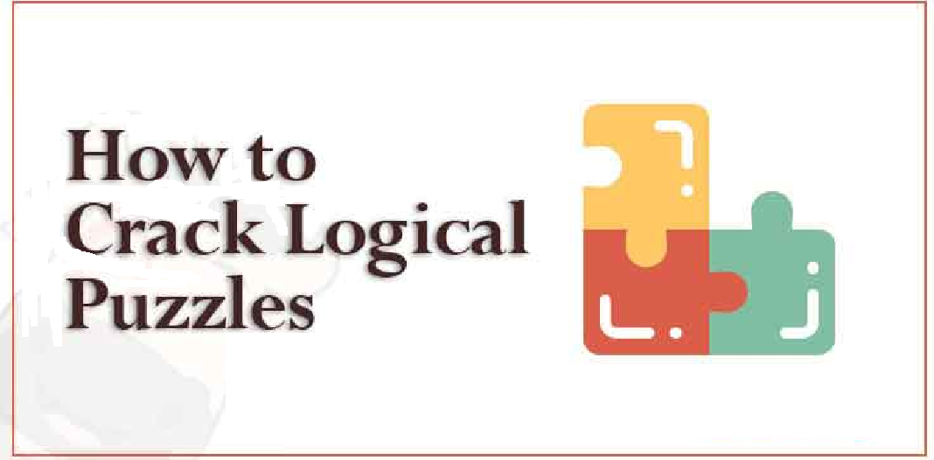
PUZZLES
Puzzle - It is the raw information given in jumbled form in a particular order. The information given need to be arranged systematically, so that all the information can be depicted correctly
Different Types of Puzzle Form:
Classification Puzzle
Selection Puzzle
Family Puzzle
Miscellaneous Puzzle

Slide 4
PUZZLES
Useful secondary information: Generally, the first few sentences of the given data give you the basic information that is required to know the general idea of the problem. This is called the ‘useful secondary information’.
Actual information: Data left after putting aside the useful secondary information is called actual information. While trying to solve the problem, you should begin with the actual information while the useful secondary information should be kept in mind.
Negative Information: Some parts of the actual information may consist of negative information. Negative information does not inform us anything exactly but it gives us a chance to eliminate a possibility. Sentences like “P is not the mother of Q” or “B is not a hill-station” are called negative information
Basic steps to solve Logical Puzzles
Take a quick look at the question.
Develop a general idea regarding the theme of the problem.
Select the data that is giving you some concrete information out of total information given. Also, select the data which helps in ruling out certain possibilities.

Slide 5
PUZZLES
Points to remember while solving Logical Puzzles:
Firstly, collect all the direct information.
Arrange the direct information in a tabular format.
Then identify all the negative information and mark it in your table according to the given data.
Other facts can be found from the indirect information
The most important point is that in some condition/s, there will be more than one possibility.
So, according to possibilities arrange them in different tables.
Reject all the tables which violate other information given in puzzle.
By following this process, you will reach at the correct answer.
Most Puzzles are tricky. So, take care of every word and sentence.

Slide 6
PUZZLES
Directions: There are seven teachers Gyan, Ram, Varun, Sam, Devdutt, Mahesh and Jadhav taking class on different subjects Tamil, English, Zoology, Botany, Physics, Chemistry and Social Science on different days starting from Monday to Sunday. All the above information is not necessarily in the same order. Ram takes Botany class on Tuesday. There are more than two classes between the classes of Botany and Zoology. Sam and Gyan are not taking either Tamil class or Social Science class. There is a gap of one day between Tamil class and Social Science class. Two persons take class between Mahesh and Sam. Neither Mahesh nor Sam takes class on either Sunday or Monday. Number of classes above and below is same for the subject of English and Chemistry respectively. Jadhav does not take Tamil class. Devdutt and Gyan are not taking classes immediately before or immediately after Sam. Gyan and Jadhav are taking class on adjacent days. English class was held on last day.
Q1.1 How many persons take class between Gyan and Devdutt?
A. None
B. One
C. Two
D. Three
Notes:
Option C
Expert (Compulsory)

Slide 7
PUZZLES
Directions: There are seven teachers Gyan, Ram, Varun, Sam, Devdutt, Mahesh and Jadhav taking class on different subjects Tamil, English, Zoology, Botany, Physics, Chemistry and Social Science on different days starting from Monday to Sunday. All the above information is not necessarily in the same order. Ram takes Botany class on Tuesday. There are more than two classes between the classes of Botany and Zoology. Sam and Gyan are not taking either Tamil class or Social Science class. There is a gap of one day between Tamil class and Social Science class. Two persons take class between Mahesh and Sam. Neither Mahesh nor Sam takes class on either Sunday or Monday. Number of classes above and below is same for the subject of English and Chemistry respectively. Jadhav does not take Tamil class. Devdutt and Gyan are not taking classes immediately before or immediately after Sam. Gyan and Jadhav are taking class on adjacent days. English class was held on last day.
Q1.2 Who amongst the following takes class exactly between Devdutt and Jadhav?
A. The one who takes class on Thursday
B. The one who takes Zoology class
C. The one who takes Class on Tuesday
D. The one who takes Tamil Class
Notes:
Option D
Expert (Compulsory)

Slide 8
PUZZLES
Directions: There are seven teachers Gyan, Ram, Varun, Sam, Devdutt, Mahesh and Jadhav taking class on different subjects Tamil, English, Zoology, Botany, Physics, Chemistry and Social Science on different days starting from Monday to Sunday. All the above information is not necessarily in the same order. Ram takes Botany class on Tuesday. There are more than two classes between the classes of Botany and Zoology. Sam and Gyan are not taking either Tamil class or Social Science class. There is a gap of one day between Tamil class and Social Science class. Two persons take class between Mahesh and Sam. Neither Mahesh nor Sam takes class on either Sunday or Monday. Number of classes above and below is same for the subject of English and Chemistry respectively. Jadhav does not take Tamil class. Devdutt and Gyan are not taking classes immediately before or immediately after Sam. Gyan and Jadhav are taking class on adjacent days. English class was held on last day.
Q1.3 If all the persons are arranged in the alphabetical order as per their names from Monday to Sunday, then who take the Tamil class and Social Science respectively?
A. Mahesh and Ram
B. Jadhav and Sam
C. Ram and Jadhav
D. Jadhav and Ram
Notes:
Option D
Expert (Compulsory)

Slide 9
PUZZLES
Directions: There are seven teachers Gyan, Ram, Varun, Sam, Devdutt, Mahesh and Jadhav taking class on different subjects Tamil, English, Zoology, Botany, Physics, Chemistry and Social Science on different days starting from Monday to Sunday. All the above information is not necessarily in the same order. Ram takes Botany class on Tuesday. There are more than two classes between the classes of Botany and Zoology. Sam and Gyan are not taking either Tamil class or Social Science class. There is a gap of one day between Tamil class and Social Science class. Two persons take class between Mahesh and Sam. Neither Mahesh nor Sam takes class on either Sunday or Monday. Number of classes above and below is same for the subject of English and Chemistry respectively. Jadhav does not take Tamil class. Devdutt and Gyan are not taking classes immediately before or immediately after Sam. Gyan and Jadhav are taking class on adjacent days. English class was held on last day.
Q1.4 Which of the following combinations is true?
Jadhav -Social Science-Thursday
B. Devdutt-Sunday-English
C. Gyan-Physics-Thursday
D. Varun-Saturday-Zoology
Notes:
Option C
Expert (Optional)

Slide 10
PUZZLES
Directions: There are seven teachers Gyan, Ram, Varun, Sam, Devdutt, Mahesh and Jadhav taking class on different subjects Tamil, English, Zoology, Botany, Physics, Chemistry and Social Science on different days starting from Monday to Sunday. All the above information is not necessarily in the same order. Ram takes Botany class on Tuesday. There are more than two classes between the classes of Botany and Zoology. Sam and Gyan are not taking either Tamil class or Social Science class. There is a gap of one day between Tamil class and Social Science class. Two persons take class between Mahesh and Sam. Neither Mahesh nor Sam takes class on either Sunday or Monday. Number of classes above and below is same for the subject of English and Chemistry respectively. Jadhav does not take Tamil class. Devdutt and Gyan are not taking classes immediately before or immediately after Sam. Gyan and Jadhav are taking class on adjacent days. English class was held on last day.
Q1.5 Who among the following takes class exactly in the middle of the week starting from Monday and ending on Sunday?
Varun
B. Gyan
C. Ram
D. Either Devdutt or Sam
Notes:
Option B
Expert (Optional)
Reqd% = 5/150 × 100 = 3.33%

Slide 11
PUZZLES
Directions: Six friends P, Q, R, S, T and U are having different chocolates among Cadbury, Five Star, Amul, Munch, Perk and Temptation but not necessarily in the same order. The cost of each chocolate is multiple of 5 in Rupees and no two chocolates have same price. All friends like different colors among Black, Blue, Green, Pink, Red and White but not necessarily in the same order. A person can have only one brand of chocolates. R has Five-Star chocolate and its cost is Rs.10 and he doesn’t like White color. U likes Green color. Q did not have Cadbury or Munch chocolate. T has a chocolate which costs Rs.20. The one person who likes Black color has Munch chocolate. P has Amul chocolate which costs Rs.25 and he likes Blue color. The cost of chocolate that S have is less than that of Five-Star chocolate. The costliest chocolate is Perk and its cost is thrice the cost of Five-Star chocolate and Q doesn’t have Perk. The cost of Cadbury chocolate is 10 Rupees less than the cost of Perk chocolate. The one who likes Pink color has Temptation chocolate. One of the persons have a chocolate which costs thrice the amount of the one who likes Black color.
Q2.1 Which among the following colors was liked by the one who has Cadbury chocolate?
A. Red
B. Green
C. White
D. Cannot be determine
Notes:
Option C
Expert (Compulsory)

Slide 12
PUZZLES
Directions: Six friends P, Q, R, S, T and U are having different chocolates among Cadbury, Five Star, Amul, Munch, Perk and Temptation but not necessarily in the same order. The cost of each chocolate is multiple of 5 in Rupees and no two chocolates have same price. All friends like different colors among Black, Blue, Green, Pink, Red and White but not necessarily in the same order. A person can have only one brand of chocolates. R has Five-Star chocolate and its cost is Rs.10 and he doesn’t like White color. U likes Green color. Q did not have Cadbury or Munch chocolate. T has a chocolate which costs Rs.20. The one person who likes Black color has Munch chocolate. P has Amul chocolate which costs Rs.25 and he likes Blue color. The cost of chocolate that S have is less than that of Five-Star chocolate. The costliest chocolate is Perk and its cost is thrice the cost of Five-Star chocolate and Q doesn’t have Perk. The cost of Cadbury chocolate is 10 Rupees less than the cost of Perk chocolate. The one who likes Pink color has Temptation chocolate. One of the persons have a chocolate which costs thrice the amount of the one who likes Black color.
Q2.2 What is the cost of the U’s chocolate?
A. Rs. 30
B. Rs. 15
C. Rs. 5
D. Rs. 50
Notes:
Option A
Expert (Compulsory)

Slide 13
PUZZLES
Directions: Six friends P, Q, R, S, T and U are having different chocolates among Cadbury, Five Star, Amul, Munch, Perk and Temptation but not necessarily in the same order. The cost of each chocolate is multiple of 5 in Rupees and no two chocolates have same price. All friends like different colors among Black, Blue, Green, Pink, Red and White but not necessarily in the same order. A person can have only one brand of chocolates. R has Five-Star chocolate and its cost is Rs.10 and he doesn’t like White color. U likes Green color. Q did not have Cadbury or Munch chocolate. T has a chocolate which costs Rs.20. The one person who likes Black color has Munch chocolate. P has Amul chocolate which costs Rs.25 and he likes Blue color. The cost of chocolate that S have is less than that of Five-Star chocolate. The costliest chocolate is Perk and its cost is thrice the cost of Five-Star chocolate and Q doesn’t have Perk. The cost of Cadbury chocolate is 10 Rupees less than the cost of Perk chocolate. The one who likes Pink color has Temptation chocolate. One of the persons have a chocolate which costs thrice the amount of the one who likes Black color.
Q2.3 Which of the following combinations is correct?
A. Temptation-Rs. 20
B. Cadbury-White
C. S-Cadbury
D. Green-Five star
Notes:
Option B
Expert (Optional)

Slide 14
PUZZLES
Directions: Six friends P, Q, R, S, T and U are having different chocolates among Cadbury, Five Star, Amul, Munch, Perk and Temptation but not necessarily in the same order. The cost of each chocolate is multiple of 5 in Rupees and no two chocolates have same price. All friends like different colors among Black, Blue, Green, Pink, Red and White but not necessarily in the same order. A person can have only one brand of chocolates. R has Five-Star chocolate and its cost is Rs.10 and he doesn’t like White color. U likes Green color. Q did not have Cadbury or Munch chocolate. T has a chocolate which costs Rs.20. The one person who likes Black color has Munch chocolate. P has Amul chocolate which costs Rs.25 and he likes Blue color. The cost of chocolate that S have is less than that of Five-Star chocolate. The costliest chocolate is Perk and its cost is thrice the cost of Five-Star chocolate and Q doesn’t have Perk. The cost of Cadbury chocolate is 10 Rupees less than the cost of Perk chocolate. The one who likes Pink color has Temptation chocolate. One of the persons have a chocolate which costs thrice the amount of the one who likes Black color.
Q2.4 What is the cost of Temptation chocolate?
A. Rs. 10
B. Rs. 20
C. Rs. 15
D. Rs. 30
Notes:
Option C
Expert (Compulsory)

Slide 15
PUZZLES
Directions: Six friends P, Q, R, S, T and U are having different chocolates among Cadbury, Five Star, Amul, Munch, Perk and Temptation but not necessarily in the same order. The cost of each chocolate is multiple of 5 in Rupees and no two chocolates have same price. All friends like different colors among Black, Blue, Green, Pink, Red and White but not necessarily in the same order. A person can have only one brand of chocolates. R has Five-Star chocolate and its cost is Rs.10 and he doesn’t like White color. U likes Green color. Q did not have Cadbury or Munch chocolate. T has a chocolate which costs Rs.20. The one person who likes Black color has Munch chocolate. P has Amul chocolate which costs Rs.25 and he likes Blue color. The cost of chocolate that S have is less than that of Five-Star chocolate. The costliest chocolate is Perk and its cost is thrice the cost of Five-Star chocolate and Q doesn’t have Perk. The cost of Cadbury chocolate is 10 Rupees less than the cost of Perk chocolate. The one who likes Pink color has Temptation chocolate. One of the persons have a chocolate which costs thrice the amount of the one who likes Black color.
Q2.5 Who has the Chocolate which costs 30 rupees?
A. R
B. S
C. T
D. U
Notes:
Option D
Expert (Optional)

Slide 16
PUZZLES
Directions: Eight friends are sitting in a circle facing towards the centre. Each of them likes different coding language i.e. C, PHP, C++, Java, Swift, Python, Ruby and Perl but not necessarily in the same order. Z, Y, X and W are females and V, U, T and S are males. Neither two female nor two male are adjacent with each other. U who likes C++, is sitting third to the right of X. X is sitting third to the right of V who likes C. No male likes Swift and Java. T is not the neigbour of V and U. S is sitting third to the right of Y who likes Ruby. W, who likes Python. Is sitting between V and U. The one who likes Swift is not the neighbour of those who like Ruby and C++.
Q3.1 Who sits third to the right of the one who likes Ruby coding language?
A. One who likes Python
B. One who likes Java
C. One who likes Swift
D. S
E. V
Notes:
Option D
Expert (Compulsory)

Slide 17
PUZZLES
Directions: Eight friends are sitting in a circle facing towards the centre. Each of them likes different coding language i.e. C, PHP, C++, Java, Swift, Python, Ruby and Perl but not necessarily in the same order. Z, Y, X and W are females and V, U, T and S are males. Neither two female nor two male are adjacent with each other. U who likes C++, is sitting third to the right of X. X is sitting third to the right of V who likes C. No male likes Swift and Java. T is not the neigbour of V and U. S is sitting third to the right of Y who likes Ruby. W, who likes Python. Is sitting between V and U. The one who likes Swift is not the neighbour of those who like Ruby and C++.
Q3.2 Which coding language does T likes?
A. Python
B. PHP
C. Perl
D. Either A or B
E. Either B or C
Notes:
Option E
Expert (Compulsory)

Slide 18
PUZZLES
Directions: Eight friends are sitting in a circle facing towards the centre. Each of them likes different coding language i.e. C, PHP, C++, Java, Swift, Python, Ruby and Perl but not necessarily in the same order. Z, Y, X and W are females and V, U, T and S are males. Neither two female nor two male are adjacent with each other. U who likes C++, is sitting third to the right of X. X is sitting third to the right of V who likes C. No male likes Swift and Java. T is not the neigbour of V and U. S is sitting third to the right of Y who likes Ruby. W, who likes Python. Is sitting between V and U. The one who likes Swift is not the neighbour of those who like Ruby and C++.
Q3.4 Four of the following five are alike in a certain way and hence they form a group. Which one of the following does not belong to that group?
A. One who likes Python
B. One who likes Java
C. One who likes Swift
D. Y
E. V
Notes:
Option E
Expert (Optional)

Slide 19
PUZZLES
Directions: Eight friends are sitting in a circle facing towards the centre. Each of them likes different coding language i.e. C, PHP, C++, Java, Swift, Python, Ruby and Perl but not necessarily in the same order. Z, Y, X and W are females and V, U, T and S are males. Neither two female nor two male are adjacent with each other. U who likes C++, is sitting third to the right of X. X is sitting third to the right of V who likes C. No male likes Swift and Java. T is not the neigbour of V and U. S is sitting third to the right of Y who likes Ruby. W, who likes Python. Is sitting between V and U. The one who likes Swift is not the neighbour of those who like Ruby and C++.
Q3.5 Who sits opposite to the V?
A. One who likes Python
B. One who likes Java
C. One who likes Swift
D. S
E. U
Notes:
Option D
Expert (Optional)

Slide 20
PUZZLES
Directions: Eight friends P, Q, R, S, T, U, V, and W, are sitting around a square table in such a way that four of them sit on four corners of the square while four sit in the middle of each of the four sides. Each of them likes different cars, viz. Alto, Porshe, Sedan, Yamaha, K10, Skoda, Acura and Jeep. The one who sits on the four corners faces the centre while those who sit in the middle of the side face outside, but not necessarily in the same order. P, who likes Porshe, faces the centre and sits third to the right of U. T, who faces the centre, likes yamaha and is not the immediate neighbour of U. S, who does not like Skoda, sits second to the right of Q, who likes neither Alto nor Skoda. S faces the centre. R is not an immediate neighbor of P. W likes Acura. Only one person sits between U and V and they likeK10 and Sedan respectively.
Q4.1 Who sits second to the left of the person who likes Yamaha?
A. W
B. V
C. P
D. Can’t be determined
E. None of these
Notes:
Option C
Expert (Compulsory)

Slide 21
PUZZLES
Directions: Eight friends P, Q, R, S, T, U, V, and W, are sitting around a square table in such a way that four of them sit on four corners of the square while four sit in the middle of each of the four sides. Each of them likes different cars, viz. Alto, Porshe, Sedan, Yamaha, K10, Skoda, Acura and Jeep. The one who sits on the four corners faces the centre while those who sit in the middle of the side face outside, but not necessarily in the same order. P, who likes Porshe, faces the centre and sits third to the right of U. T, who faces the centre, likes active and is not the immediate neighbour of U. S, who does not like Skoda, sits second to the right of Q, who likes neither Alto nor Skoda. S faces the centre. R is not an immediate neighbor of P. W likes Acura. Only one person sits between U and V and they likeK10 and Sedan respectively.
Q4.2 What is the position of T with respect to the person who likes K10?
A. Third to the right
B. Fourth to the right
C. Sixth to the right
D. Third to the left
E. None of these
Notes:
Option D
Expert (Compulsory)

Slide 22
PUZZLES
Directions: Eight friends P, Q, R, S, T, U, V, and W, are sitting around a square table in such a way that four of them sit on four corners of the square while four sit in the middle of each of the four sides. Each of them likes different cars, viz. Alto, Porshe, Sedan, Yamaha, K10, Skoda, Acura and Jeep. The one who sits on the four corners faces the centre while those who sit in the middle of the side face outside, but not necessarily in the same order. P, who likes Porshe, faces the centre and sits third to the right of U. T, who faces the centre, likes active and is not the immediate neighbour of U. S, who does not like Skoda, sits second to the right of Q, who likes neither Alto nor Skoda. S faces the centre. R is not an immediate neighbor of P. W likes Acura. Only one person sits between U and V and they likeK10 and Sedan respectively.
Q4.3 Who likes Splendor?
A. Q
B. S
C. R
D. Can’t be determined
E. None of these
Notes:
Option C
Expert (Optional)

Slide 23
PUZZLES
Directions: Eight friends P, Q, R, S, T, U, V, and W, are sitting around a square table in such a way that four of them sit on four corners of the square while four sit in the middle of each of the four sides. Each of them likes different cars, viz. Alto, Porshe, Sedan, Yamaha, K10, Skoda, Acura and Jeep. The one who sits on the four corners faces the centre while those who sit in the middle of the side face outside, but not necessarily in the same order. P, who likes Porshe, faces the centre and sits third to the right of U. T, who faces the centre, likes active and is not the immediate neighbour of U. S, who does not like Skoda, sits second to the right of Q, who likes neither Alto nor Skoda. S faces the centre. R is not an immediate neighbor of P. W likes Acura. Only one person sits between U and V and they likeK10 and Sedan respectively.
Q4.4 Which of the following is true regarding R?
A. R is immediate neighbour of U
B. R faces the centre
C. R likes Alto
D. Q sits third to the left of R
E. None of these
Notes:
Option E
Expert (Compulsory)

Slide 24
PUZZLES
Directions: Eight friends P, Q, R, S, T, U, V, and W, are sitting around a square table in such a way that four of them sit on four corners of the square while four sit in the middle of each of the four sides. Each of them likes different cars, viz. Alto, Porshe, Sedan, Yamaha, K10, Skoda, Acura and Jeep. The one who sits on the four corners faces the centre while those who sit in the middle of the side face outside, but not necessarily in the same order. P, who likes Porshe, faces the centre and sits third to the right of U. T, who faces the centre, likes active and is not the immediate neighbour of U. S, who does not like Skoda, sits second to the right of Q, who likes neither Alto nor Skoda. S faces the centre. R is not an immediate neighbor of P. W likes Acura. Only one person sits between U and V and they likeK10 and Sedan respectively.
Q4.5 Four of the following five are alike in a certain way and hence they form a group. Which one of the following does not belong to that group?
A. U
B. V
C. W
D. T
E. R
Notes:
Option D
Expert (Optional)

Slide 25
PUZZLES
Directions: Six persons are sitting in a triangular table. The person who sit at the corner faces outside the centre and the one who sits in the middle of the side face towards the centre. Each of them likes different colours. i.e. Black, Violet, Brown, Silver, Magenta and Gold (but not necessarily in the same order).
The one who likes silver colour sits to the immediate right of P. Only one person sits between P and U. The one who likes Brown colour sits second to the right of the one who likes violet colour. Q likes magenta colour and is not an immediate neighbour of P and U. U does not like brown colour. U is not an immediate neighbour of the one who likes violet colour. S sits second to the left of R. S is not an immediate neighbour of P. T face inside. P dose not like gold colour.
Q5.1 Who sit fourth to the left of the Q?
A. One who likes Black colour
B. One who likes Violet colour
C. U
D. R
E. None of these
Notes:
Option A
Moderate (Compulsory)

Slide 26
PUZZLES
Directions: Six persons are sitting in a triangular table. The person who sit at the corner faces outside the centre and the one who sits in the middle of the side face towards the centre. Each of them likes different colours. i.e. Black, Violet, Brown, Silver, Magenta and Gold (but not necessarily in the same order).
The one who likes silver colour sits to the immediate right of P. Only one person sits between P and U. The one who likes Brown colour sits second to the right of the one who likes violet colour. Q likes magenta colour and is not an immediate neighbour of P and U. U does not like brown colour. U is not an immediate neighbour of the one who likes violet colour. S sits second to the left of R. S is not an immediate neighbour of P. T face inside. P dose not like gold colour.
Q5.2 Which colour does T likes?
A. Black
B. Violet
C. Gold
D. Brown
E. None of these
Notes:
Option B
Moderate (Compulsory)

Slide 27
PUZZLES
Directions: Six persons are sitting in a triangular table. The person who sit at the corner faces outside the centre and the one who sits in the middle of the side face towards the centre. Each of them likes different colours. i.e. Black, Violet, Brown, Silver, Magenta and Gold (but not necessarily in the same order).
The one who likes silver colour sits to the immediate right of P. Only one person sits between P and U. The one who likes Brown colour sits second to the right of the one who likes violet colour. Q likes magenta colour and is not an immediate neighbour of P and U. U does not like brown colour. U is not an immediate neighbour of the one who likes violet colour. S sits second to the left of R. S is not an immediate neighbour of P. T face inside. P dose not like gold colour.
Q5.3 Which of the following combinations is true?
A. Q - gold
B. T - black
C. R - Silver
D. S - Magenta
E. None of these
Notes:
Option C
Moderate (Optional)

Slide 28
PUZZLES
Directions: Six persons are sitting in a triangular table. The person who sit at the corner faces outside the centre and the one who sits in the middle of the side face towards the centre. Each of them likes different colours. i.e. Black, Violet, Brown, Silver, Magenta and Gold (but not necessarily in the same order).
The one who likes silver colour sits to the immediate right of P. Only one person sits between P and U. The one who likes Brown colour sits second to the right of the one who likes violet colour. Q likes magenta colour and is not an immediate neighbour of P and U. U does not like brown colour. U is not an immediate neighbour of the one who likes violet colour. S sits second to the left of R. S is not an immediate neighbour of P. T face inside. P dose not like gold colour.
Q5.4 Four of the following five are alike in a certain way and hence they form a group. Which one of the following does not belong to that group?
A. Q
B. P
C. One who likes gold colour
D. One who likes Silver colour
Notes:
Option D
Moderate (Compulsory)

Slide 29
PUZZLES
Directions: Six persons are sitting in a triangular table. The person who sit at the corner faces outside the centre and the one who sits in the middle of the side face towards the centre. Each of them likes different colours. i.e. Black, Violet, Brown, Silver, Magenta and Gold (but not necessarily in the same order).
The one who likes silver colour sits to the immediate right of P. Only one person sits between P and U. The one who likes Brown colour sits second to the right of the one who likes violet colour. Q likes magenta colour and is not an immediate neighbour of P and U. U does not like brown colour. U is not an immediate neighbour of the one who likes violet colour. S sits second to the left of R. S is not an immediate neighbour of P. T face inside. P dose not like gold colour.
Q5.5 Who sit third to the right of the R?
A. One who likes Black colour
B. One who likes Magenta colour
C. U
D. One who likes Brown colour
E. None of these
Notes:
Option B
Moderate (Optional)

Slide 30
Syllogism

Slide 31
Syllogism
Syllogism
Introduction
Venn diagrams of statements and inferring solutions from them and vice-versa
Cases with possibility, either-or situation and Reverse Syllogism.
Data Sufficiency

Slide 32
Syllogism
SYLLOGISM
A syllogism is a logical argument where a quantified statement of a specific form (the conclusion) is inferred from two other quantified statements (the premises).
Types of statements:
There are four types of statements in syllogism
1. All
2. Some
3. No
4. Some not
These statements can be represented will the help of Venn diagram

Slide 33
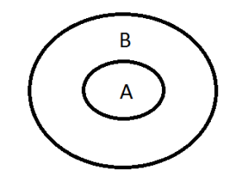
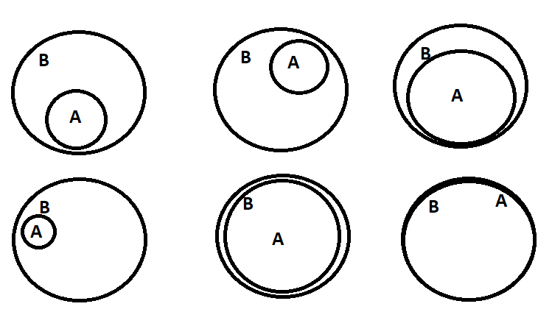
Syllogism
1.) All STATEMENT
All statement is written in the format “ALL A are B”, here A and B represent the subject and object of the statement.
Venn diagram

Slide 34
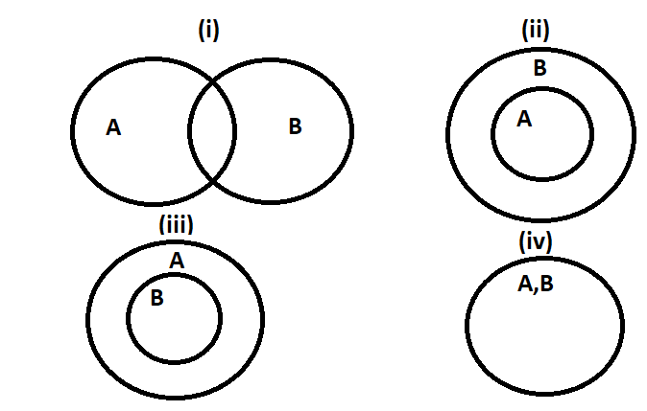
Syllogism
2.) SOME STATEMENT
Some statement is written in the format “Some A are B”, here A and B represent the subject and object of the statement.

Slide 35
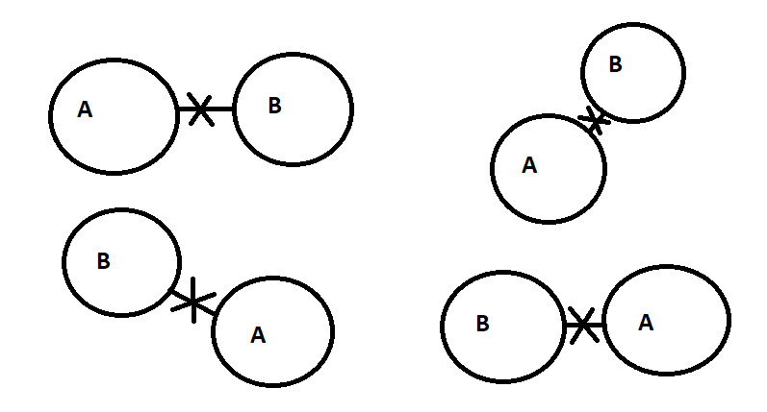
Syllogism
3.) NO STATEMENT
No statement is written in the format “No A are B”, here A and B represent the subject and object of the statement

Slide 36
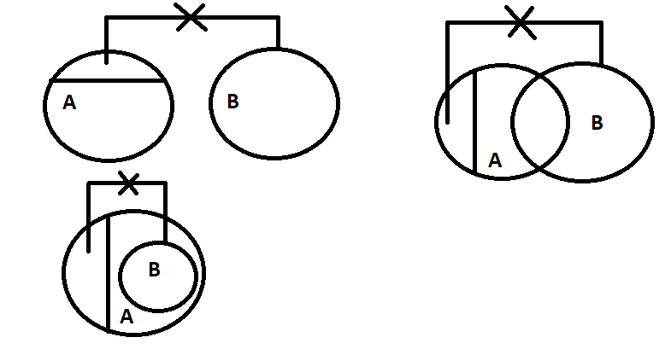
Syllogism
4.) SOME NOT STATEMENT
All statement is written in the format “Some A are not B”, here A and B represent the subject and object of the statement.

Slide 37
Syllogism

Slide 38
Syllogism
Directions : In each of the following questions two statements are given and these statements are followed by two conclusions numbered (1) and (2). You have to take the given two statements to be true even if they seem to be at variance from commonly known facts. Read the conclusions and then decide which of the given conclusions logically follows from the two given statements, disregarding commonly known facts.
Give answer:
(A) If only (1) conclusion follows
(B) If only (2) conclusion follows
(C) If either (1) or (2) follows
(D) If neither (1) nor (2) follows and
(E) If both (1) and (2) follow.

Slide 39
Syllogism
Q1. Statements:
Some carrots are potatoes
No potatoes are tomatoes
Conclusions:
Some tomatoes are not carrots
Some carrots are not tomatoes
Notes:
Option B
Easy (Compulsory)

Slide 40
Syllogism
Q2. Statements:
Some locks are keys
All keys are handles
Conclusions:
(1) Some handles are locks
(2) Some handles are not locks
Notes:
Option A
Easy (Compulsory)

Slide 41
Syllogism
Q3. Statements:
All windows are walls
No walls are doors
No doors are roof
Conclusions:
No walls are roof
No doors are windows
Notes:
Option B
Easy (Compulsory)

Slide 42
Syllogism
Q4. Statements:
Some hands are hair
All hair are heads
All heads are heart
Conclusions:
(1) Some hearts are hands
(2) No heads are hand
Notes:
Option A
Easy (Optional)

Slide 43
Syllogism
Q5. Statements:
Some fans are coolers
All coolers are televisions
No televisions are tube light
Conclusions:
Some fans are not tube light
No coolers are tube light
Notes:
Option E both follows
Easy (Compulsory)

Slide 44
Syllogism
Q6. Statements:
All man are rich
All rich are gentle
Some gentle are intelligent
Conclusions:
(1) All man are intelligent
(2) No man are intelligent
Notes:
Option D neither follows
Easy (Optional)

Slide 45
Syllogism
Q7. Statements:
Some pens are erasers
Some erasers are pencils
No pencils are sharpeners
Conclusions:
Some pens are pencils
Some sharpeners are not erasers
Notes:
Option D
Easy (Compulsory)

Slide 46
Syllogism
Q8. Statements:
Some buses are scooters
No scooters are bikes
All bikes are ships
Conclusions:
(1) Some bikes are not buses
(2) Some ships are not scooters
Notes:
Option B
Easy (Optional)

Slide 47
Syllogism
DIRECTIONS:
In each of the questions below are given three statements, followed by conclusions: I, II, III, IV. You have to take the given statements to be true even if they seem to be at variance from commonly known facts. Read the conclusions and then decide which of the given conclusions logically follows from the given statements disregarding commonly known facts.

Slide 48
Syllogism
Q9. Statements:
Some hens are dogs.
All frog are chairs.
All dogs are frog. Conclusion:
I. Some hens are frog
II. All frog are dogs
III. All chairs are hens
IV. All frog are hens
A. Only I & II follow
B. Only II follows
C. Only I & IV follow
D. None of these
Notes:
Option D
Moderate (Compulsory)

Slide 49
Syllogism
Q10. Statements:
Some hooks are crooks.
All crooks are greens.
Some greens are yellow. Conclusion:
I. Some yellow are crooks.
II. Some greens are crooks.
III. Some greens are hooks.
IV. Some yellow are hooks
A. All follow
B. Only II and III follow
C. Only III follows
D. Only IV follows
Notes:
Option B
Moderate (Optional)

Slide 50
Syllogism
Q11. Statements:
All lawyers are innocents.
Some mobile are lawyers.
All bedsheets are mobile. Conclusion:
I. All bedsheet are innocents
II. Some bedsheet are innocents
III. Some innocents are mobiles
IV. All mobile are innocents
A. Only I follows
B. Only II follows
C. Only I and III follow
D. Only III follows
Notes:
Option D
Moderate (Compulsory)

Slide 51
Syllogism
Q12. Statements:
Most mobiles are keyboards.
No keyboard is a printer.
All printers are mobiles. Conclusion:
I. Some keyboards are mobiles
II. All mobiles are printer
III. No printer is a keyboard
IV. Some printer are keyboard
A. Only I follows
B. Only II and III follow
C. Only I and III follow
D. Only II follows
Notes:
Option C
Moderate (Compulsory)

Slide 52
Syllogism
Q13. Statements:
All Gulab Jamun are Jalebi.
All Jalebis are burger.
All burgers are Barfi Conclusion:
I. All Jalebis are Barfi
II. All Gulab Jamun are Burger
III. All Gulab Jamun are Barfi
IV. All Barfi are Jalebi
A. Only I and II follow
B. Only I and III follow
C. Only II and III follow
D. Only I, II and III follow
Notes:
Option D
Moderate (Optional)

Slide 53
Syllogism
Q14. Statements:
Some feet are ears.
Some ears are kidneys.
All kidneys are hairs Conclusion:
I. Some hairs are feet.
II. Some hairs are ears
III. Some kidneys are feet
IV. No hair is foot
A. None follow
B. Only IV follows
C. Only II follows
D. Only III follows
Notes:
Option C
Moderate (Compulsory)

Slide 54
Syllogism
Q15. Statements:
All triangles are rectangles.
Some rectangles are sphere.
All sphere are cones Conclusion:
I. Some cones are rectangles
II. Some cones are triangles
III. Some sphere are triangles
IV. Some rectangles are cones
A. None follows
B. Only I and II follow
C. Only III and IV follow
D. Only I and IV follow
Notes:
Option D
Moderate (Optional)

Slide 55
Syllogism
Q16. Statements:
All mercury are iron.
No iron is chlorine.
Some graphite are chlorine. Conclusion:
I. Some graphite are mercury
II. Some graphite are iron
III. Some mercury are chlorine
IV. No chlorine is mercury
A. Only I follows
B. Only III follows
C. Only IV follows
D. Only II and IV follow
Notes:
Option C
Moderate (Optional)

Slide 56
Syllogism
Q17. Statements:
Some chats are yahoo.
All WhatsApp are yahoo.
All yahoo are google. Conclusion:
I. Some google are chats
II. All WhatsApp are google
III. Some chats are WhatsApp
IV. Some chat are google
A. All follow
B. Only I, II and III follow
C. Only I, II and IV follow
D. Only III and IV follow
Notes:
Option C
Moderate (Optional)

Slide 57
Syllogism
Q18. Statements:
No tyre is round.
No round is cycle.
Some scooty are cycle Conclusion:
I. No cycle is tyre
II. No cycle is round
III. Some rounds are tyres
IV. All cycles are tyres
A. None follows
B. Only I follows
C. Only I and III follow
D. None of these
Notes:
Option D
Moderate (Compulsory)

Slide 58
Syllogism
Q19. Statements:
Some mountains are states
Some states are oceans
Conclusions:
(1) Some mountains are oceans
(2) No mountains are oceans
(A) If only (1) conclusion follows
(B) If only (2) conclusion follows
(C) If either (1) or (2) follows
(D) If neither (1) nor (2) follows and
(E) If both (1) and (2) follow.
Notes:
Option C
Easy (Compulsory)

Slide 59
Syllogism
Q20. Statements:
All apples are mangoes
All mangoes are bananas
Conclusions:
(1) Some apples are mangoes
(2) Some mangoes are not apples is a possibility
(A) If only (1) conclusion follows
(B) If only (2) conclusion follows
(C) If either (1) or (2) follows
(D) If neither (1) nor (2) follows and
(E) If both (1) and (2) follow.
Notes:
Option E
Easy (Compulsory)

Slide 60
Syllogism
Direction: In each of the following questions three/four statements are given and these statements are followed by four conclusions numbered (I) , (II) , (III) and (IV) . You have to take the given two statements to be true even if they seem to be at variance from commonly known facts. Read the conclusions and then decide which of the given conclusions logically follows from the given statements. Disregarding commonly known facts.

Slide 61
Syllogism
Q21. Statements:
No car is bus.
All train are car.
Some trucks are buses
Conclusions:
I) All train being bus is a possibility
II) Some trucks are not buses
III) No train is bus
IV) Some trucks are car is a possibility
A. Only conclusion I follow
B. Only conclusion I and III follow
C. Only conclusion I, III and IV follow
D. Only II follows
E. None of these
Notes:
Option E
Moderate (Compulsory)

Slide 62
Syllogism
Q22. Statements:
Some rooms are window.
All windows are door.
All rooms are building.
Conclusions:
I) some buildings may be part of windows
II) Some buildings are not window
III) All building are doors is a possibility
IV) All rooms which are buildings are also windows
A. Only conclusion I follow
B. Only conclusion III follows
C. Only conclusion I, III and IV follow
D. Only II follow
E. None of these
Notes:
Option B
Moderate (Optional)

Slide 63
Syllogism
Directions: In each of these questions two Conclusions have been given followed by 5 sets of possible Statements. You have to take the given Conclusions to be true even if they seem to be at variance with the commonly known facts and then decide that the Conclusions logically follows for which of the given statements disregarding commonly known facts

Slide 64
Syllogism
Q23. Conclusions:
At least some bags are shirts.
None but bags are coats is a possibility.
A. Statements: Some shirts are coats. some coats are bags. All bags are caps. No caps are shirts.
B. Statements: some coats are shirts. some shirts are bags. some coats are bags .All bags are caps.
C. Statements: All shirts are coats. No coats are caps. All caps are bags. Some coats are bags.
D. Statements: Some bags are coats. Some coats are cap. some caps are shirts. Some shirts are coats.
Notes:
Option B
Expert (Compulsory)

Slide 65
Syllogism
Q24. Conclusions:
At least some films are plays.
No multiplex are action.
A. Statements: Only multiplex are plays. Few multiplex are film. Some plays are action. No action is film.
B. Statements: All multiplex are plays. No multiplex are films. All plays are action. All films are action.
C. Statements: All multiplex are plays. Some multiplex are films. No film is a action. Some plays are action.
D. Statements: Some multiplex are plays. Some multiplex are films. No actions are multiplex. Some plays are action.
E. Statements: No action is multiplex. Some multiplex are films. All multiplex are plays. No actions are films.
Notes:
Option E
Expert (Optional)

Slide 66
Syllogism
Q25. Conclusions:
Some radios are not laptops.
Almost 50 % radios are signals.
A. Statements: some radios are laptops. All radios are book. None of these laptops are signals. Some signal is books.
B. Statements: No machines are signals. Some laptops are signals. No signals are book. No radios are laptops.
C. Statements: All signals are radios. Rarely books are radios. No laptops are book. Some books are signals.
D. Statements: All books are laptops. No laptops are machines. No signals are radios. Some machines are radios.
E. Both c and d follows.
Notes:
Option C
Expert (Compulsory)

Slide 67
Syllogism
Q26. Conclusions:
At least some kiwis are dry fruits.
Some bananas are not a dry fruits is a possibility.
A. Statements: Some cherries are dry fruits. Some dry fruits are kiwis. Some cherries are bananas.
B. Statements: No kiwis are dry fruits. Some dry fruits are cherries. Some cherries are bananas.
C. Statements: All dry fruits are bananas. Some bananas are kiwis. No kiwis are cherries.
D. None follows
E. Only a and b
Notes:
Option A
Expert (Optional)

Slide 68
Syllogism
Q27. Conclusions:
Some whites are not violet.
All greens are being pink is a possibility.
All yellows being greens is a possibility.
A. Statement: All greens are violets. All violets are pink. Some pinks are whites. Some whites are yellows.
B. Statement: Some violets are pink. Some pink are yellows. All whites are yellows. All greens are pink.
C. Statement: Some greens are violet. Some violets are pink. All yellows are greens. No yellow is white.
D. Statement: Some greens are violets. Some violets are pink. No violet is white. Some whites are yellow.
E. None of these
Notes:
Option D
Expert (Compulsory)

Slide 69
Syllogism
Q28. Conclusions:
Some Tomatoes is pea nuts
Some Tomatoes are not Potatoes
Some Tomatoes which are Carrot are also oranges is a possibility
A. Statement: Some Carrot is Tomatoes. All pea nuts is Carrot. No Potatoes is Carrot. Some pea nuts is oranges.
B. Statement: Some Carrot is oranges. No Potatoes is pea nuts. All pea nuts is Tomatoes. Some Carrot is Tomatoes.
C. Statement: No Carrot is potatoes. Some tomatoes are pea nuts. Some Potatoes is pea nuts. Some Potatoes is oranges.
D. Statement: Some Carrot is Tomatoes. Some pea nuts is Carrot. No Potatoes is Carrot. Some pea nuts is oranges.
E. None of these.
Notes:
Option B
Expert (Compulsory)

Slide 70
Syllogism
Q29. Conclusions:
No dusters is marker
Some papers are files
All books are marker is a possibility
A. Statements: All books are papers. some papers are marker. No marker are flowers. All files are dusters
B. Statements: All dusters is books. All books are papers. some books are marker. No marker is files.
C. Statements: No books are papers. some dusters are papers. all dusters are files. No marker are files.
D. Statements: All papers are files. No files are dusters. All books are dusters. All dusters are marker.
E. None of these.
Notes:
Option C
Expert (Optional)

Slide 71
Syllogism
Q30. Conclusions:
No tiger is horse
Some monkeys are not zebra
Some dogs are not tiger
A. Statements: Some tigers are horse. All monkeys are dog. No dog is zebra. No zebra is tiger
B. Statements: All tigers are monkey. All monkeys are dog. No dog is horse. some zebra is horse
C. Statements: All horses are dog. some zebra are horses. No dog are monkey. All monkey are tiger.
D. Statements: some horses are dog. All dogs are zebra. No zebra is tiger. some tiger is monkey.
E. None of these.
Notes:
Option E
Expert (Optional)

Slide 72
Syllogism
Directions Q 31. In each of the questions below consists of a question and two statements numbered I and II given below it. You have to decide whether the data provided in the statements are sufficient to answer the question. Read both the statements and
Give answer
(A) If the data in statement I alone are sufficient to answer the question, while the data in statement II alone are not sufficient to answer the question
(B) If the data in statement II alone are sufficient to answer the question, while the data in statement I alone are not sufficient to answer the question
(C) If the data either in statement I alone or in statement II alone are sufficient to answer the question
(D) If the data given in both statements I and II together are not sufficient to answer the question and
(E) If the data in both statements I and II together are necessary to answer the question.

Slide 73
Syllogism
Q32. The conclusion “some sofa are desktop” definitely do not follow from the statements.
Statement I: Some sofa are furniture, some furniture are desktop
Statement II: All sofa are furniture, no furniture are desktop
Notes:
Option B
Easy (Compulsory)

Slide 74
Syllogism
Q33. The conclusion “No army is police” definitely do not follow from the statements.
Statement I: Some army is hard workers, All hard workers are police
Statement II: All army is hard workers, No hard workers are police
Notes:
Option A
Easy (Optional)

Slide 75
Syllogism
Q34. The conclusion “All laptops are desktops” definitely do not follow from the statements.
Statement I: All laptops are computer, No computers are desktop
Statement II: Some laptops are computer, No computers are desktop
Notes:
Option C
Easy (Compulsory)

Slide 76
Syllogism
Q35. The conclusion “some orange are green” definitely do not follow from the statements.
Statement I: All orange are yellow, Some yellow are green
Statement II: No orange are yellow, no yellow are green
Notes:
Option D
Easy (Optional)

Slide 77
Syllogism
Q36. The conclusion “some bats are cats” definitely do not follow from the statements.
Statement I: All bats are rats, no rats are cats
Statement II: Some bats are rats, no rats are cats
Notes:
Option A
Easy (Optional)

Slide 78
Syllogism
Any Doubts???
Notes:
Option A
Easy (Optional)

